Slide 1
Paris
Paris2Connect
Mathieu GARNIER (ATC)

Slide 2
Use Cases: G1 et G2

Slide 3
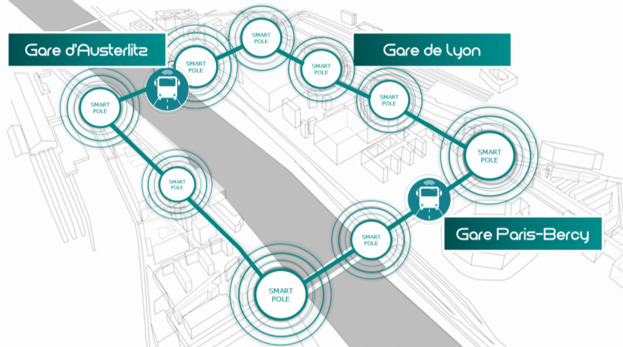
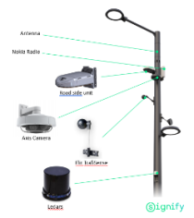
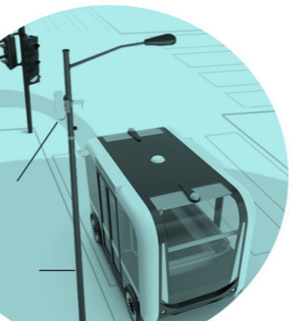
Very dense urban area – 3 stations linked on a 3km pathway
9 Smart Poles
9 connected crossroads with NeoGLS RSU

Slide 4
General implementation scheme
C-ITS data & Supervision
Relay server& Supervision
RSU Traffic light
PCRT (TMS)
LUTECE
PKI
Server Idnomic
Diaser
C-ITS data
UEV
CCF
Diaser
C-ITS data & Supervision

Slide 5
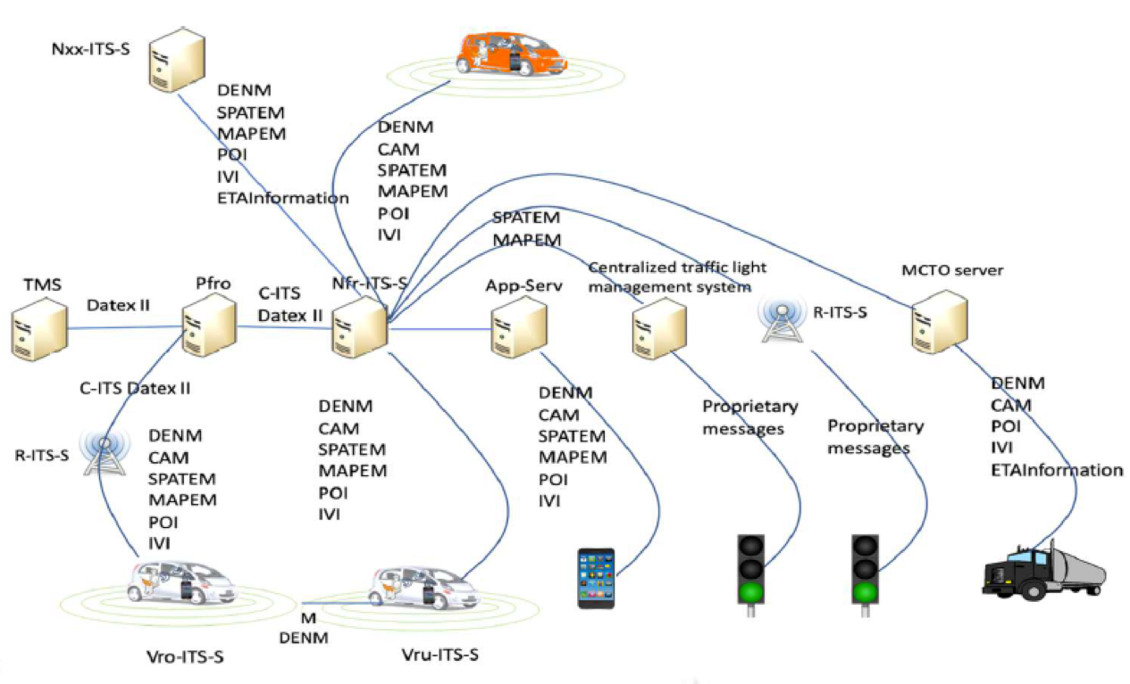
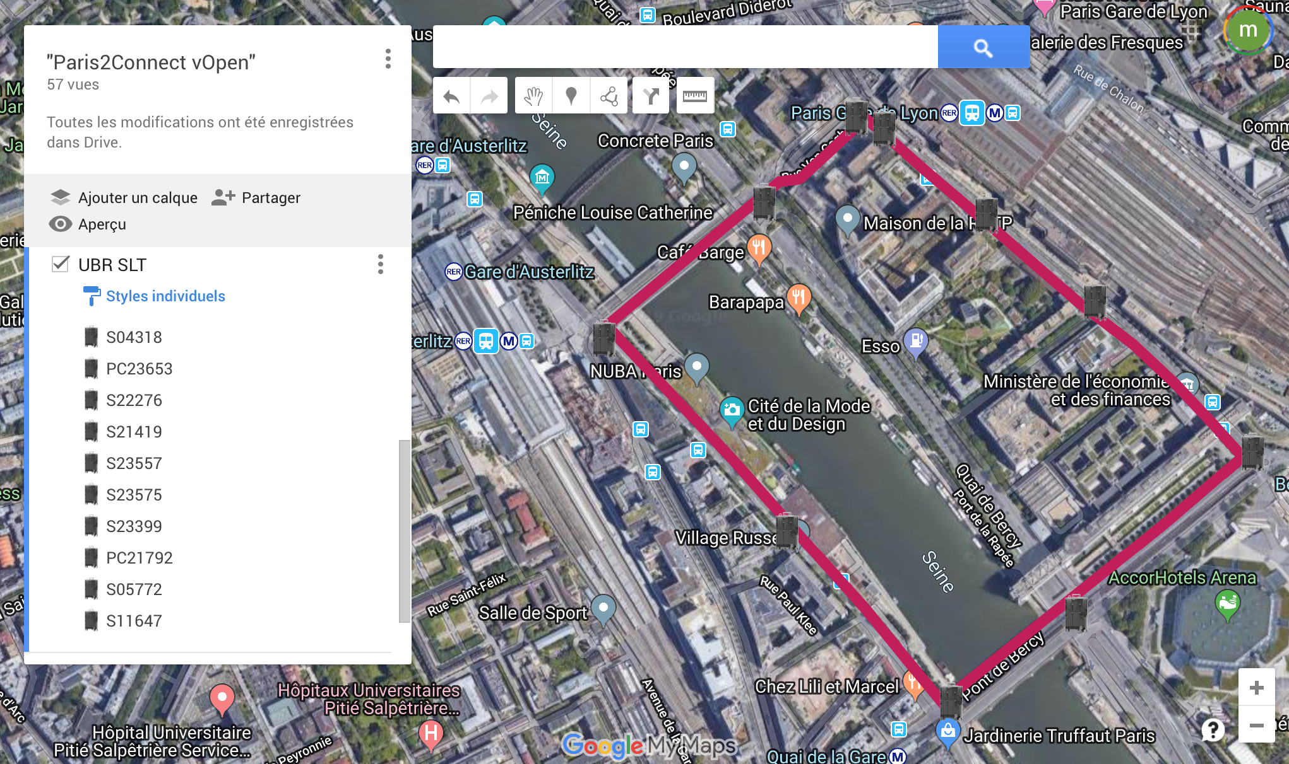
General implementation scheme and beyond
No national production launch
No deployment at this stage

Slide 6
Success and difficulties encountered
Success
Successful mobilization allowing the implementation and G1 and G2 tests carried out within 18 months of the start of the project
Innovation approach implemented on use cases other than connected vehicle use (outside Indid scope) to develop community interest
Difficulties
Subject quality of controller / Central Traffic Control Station links
Dense urban use case
Public policies aim rather to reduce the presence of vehicles in urban centers and therefore non-priority investments (priority to soft mobility)
Interest in use cases if rapid scaling up (priority at traffic lights, pedestrian crossings for visually impaired people, etc.)
Strong maintenance in operational conditions requirements due to support for new “information” management activities from the road infrastructure to other interfaces, supported by other equipment

