Slide 1
Pilot Site A6 IdF
APRR - Benoît Vuadelle - CCAM expert

Slide 2
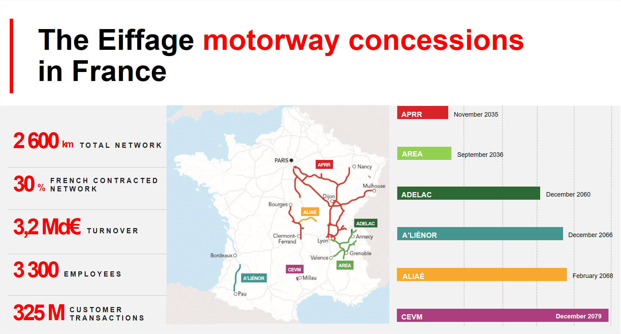

Slide 3
MOTIVATIONS

Slide 4
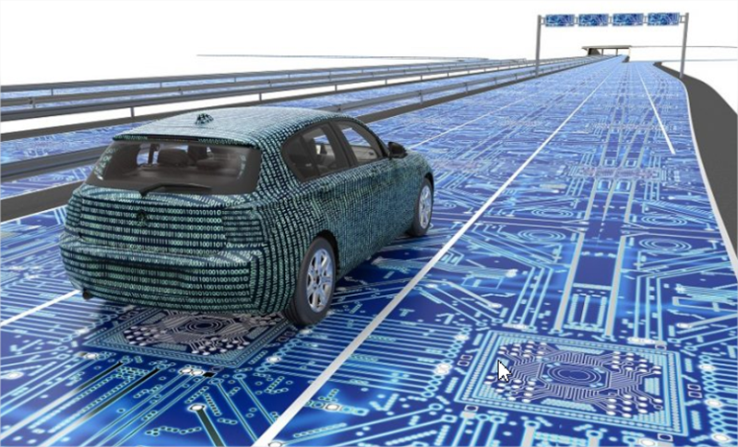
APRR
Challenges around C-ITS
Prepare a connected motorway infrastructure
Safety of the interventions of our roadworkers
Safety of road users
Contribute to new needs for automated mobility, in particular the extension of Operational Design Domain (ODD) for an AV
Provide access to test pilot sites on open roads

Slide 5
Pilot site A6
Ile de France

Slide 6

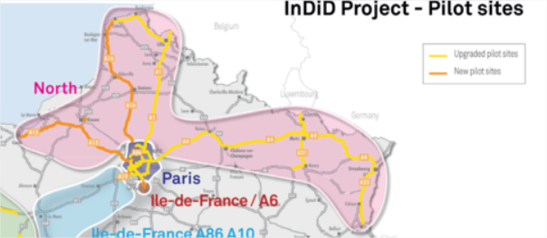


Pilot Site « A6 IdF » location

Slide 7
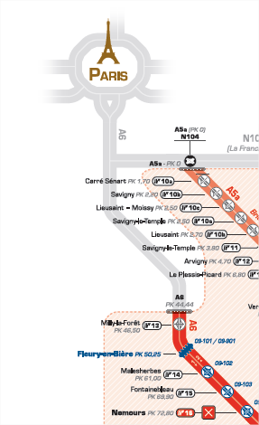
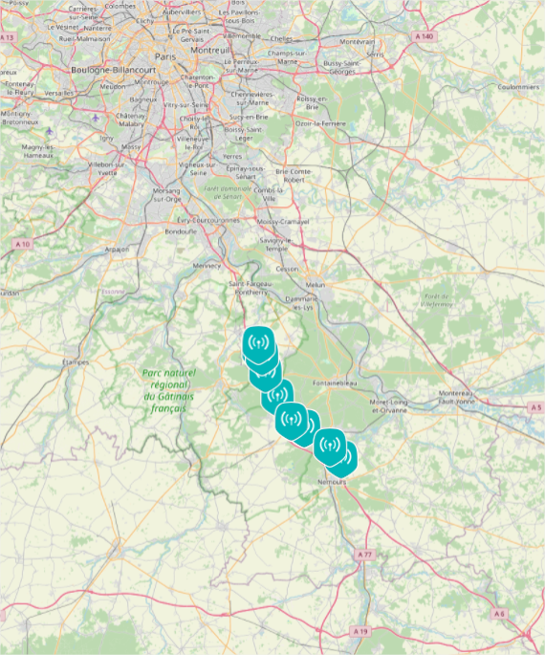


Pilot Site « A6 IdF » location
9 RSUs

Slide 8
Use Cases

Slide 9
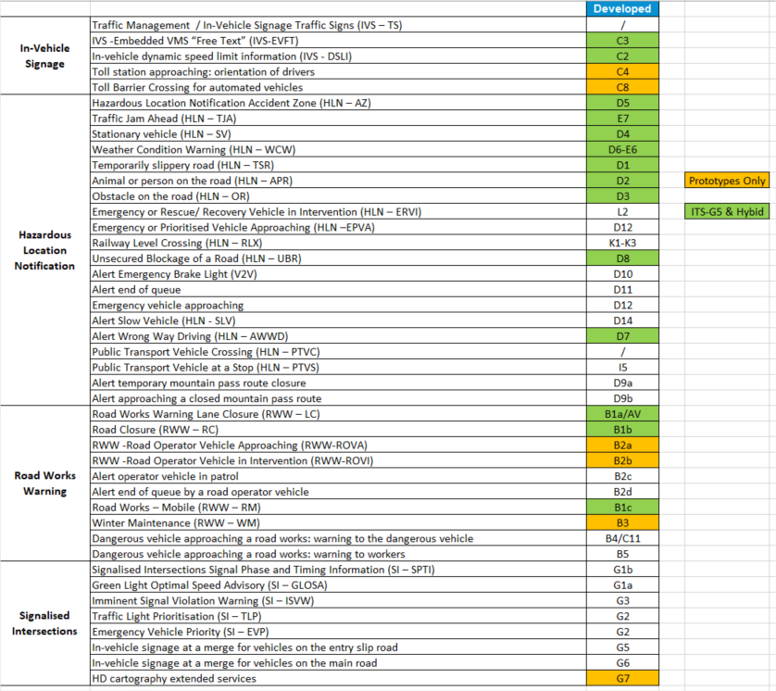
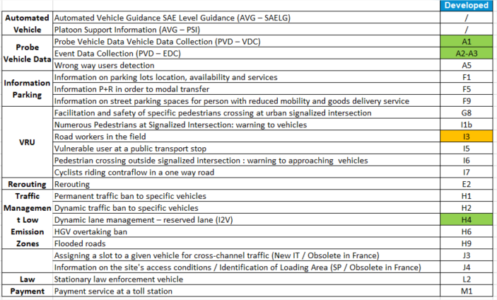
Implemented Use Cases

Slide 10
FOCUS
Level 3-4 Automated Vehicle negotiating a single lane closure

Slide 11
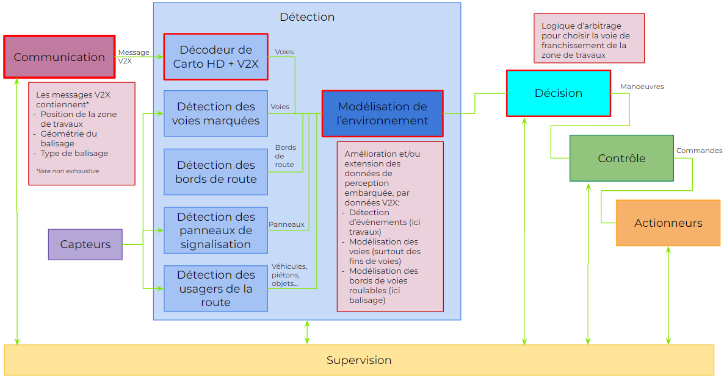
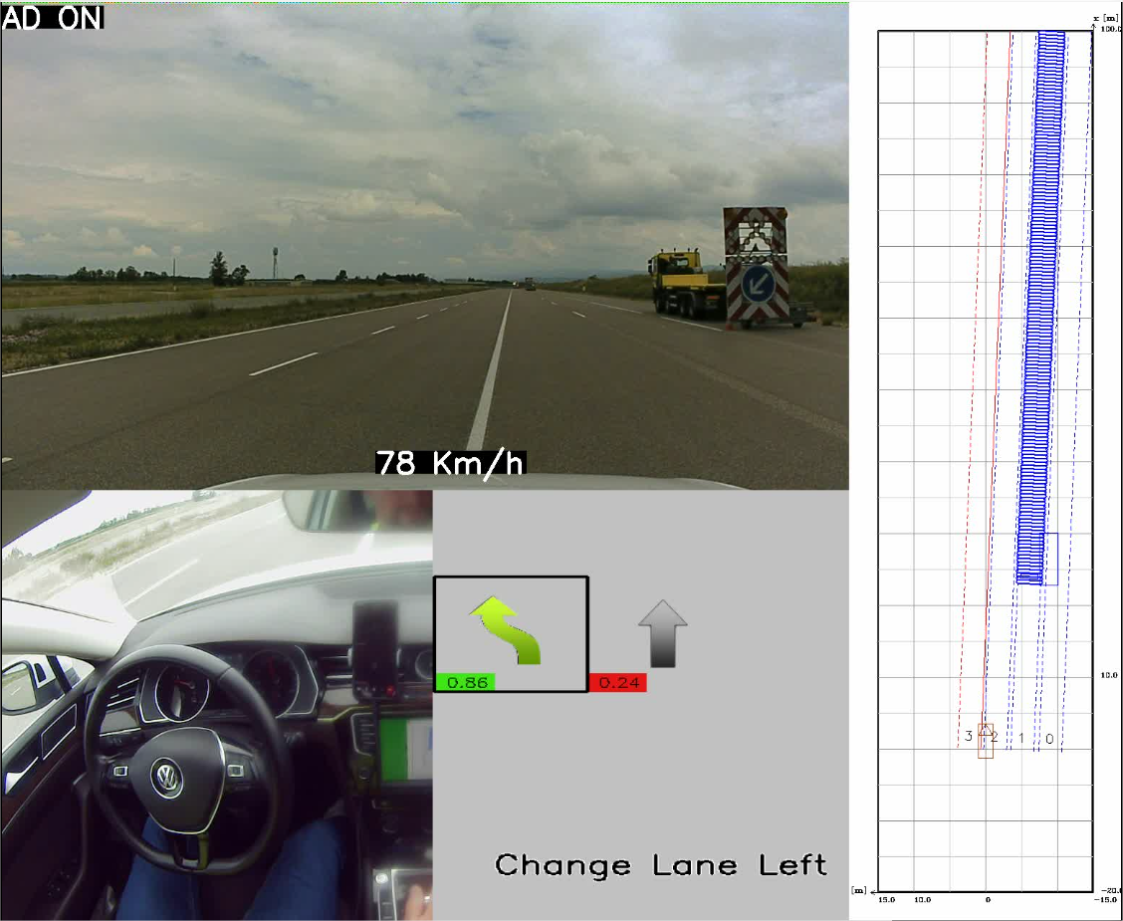
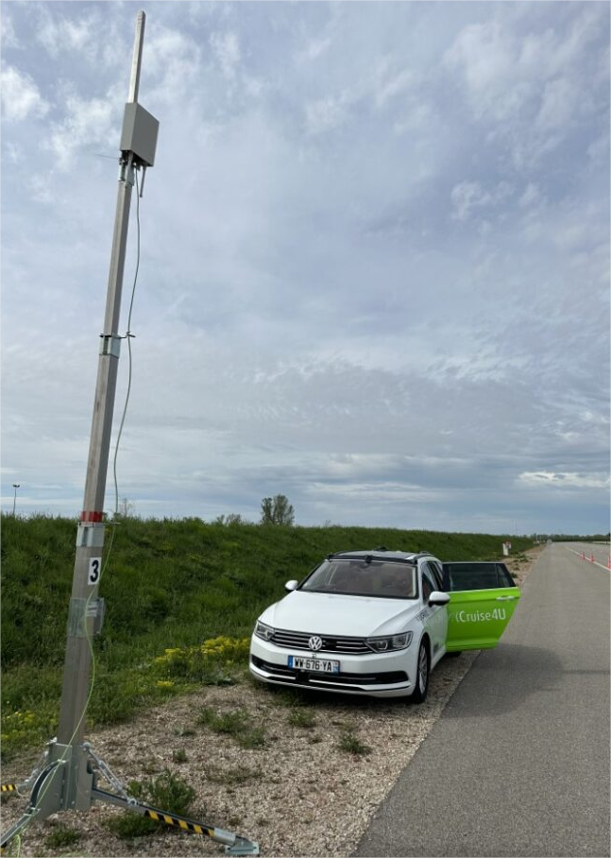
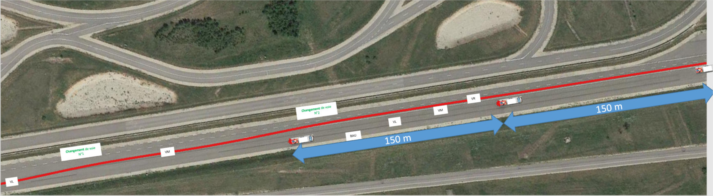
AV negotiating a lane closure
Use Case RWW and AV
Lane closure
I2V: DENM+ Recommended Path

Slide 12
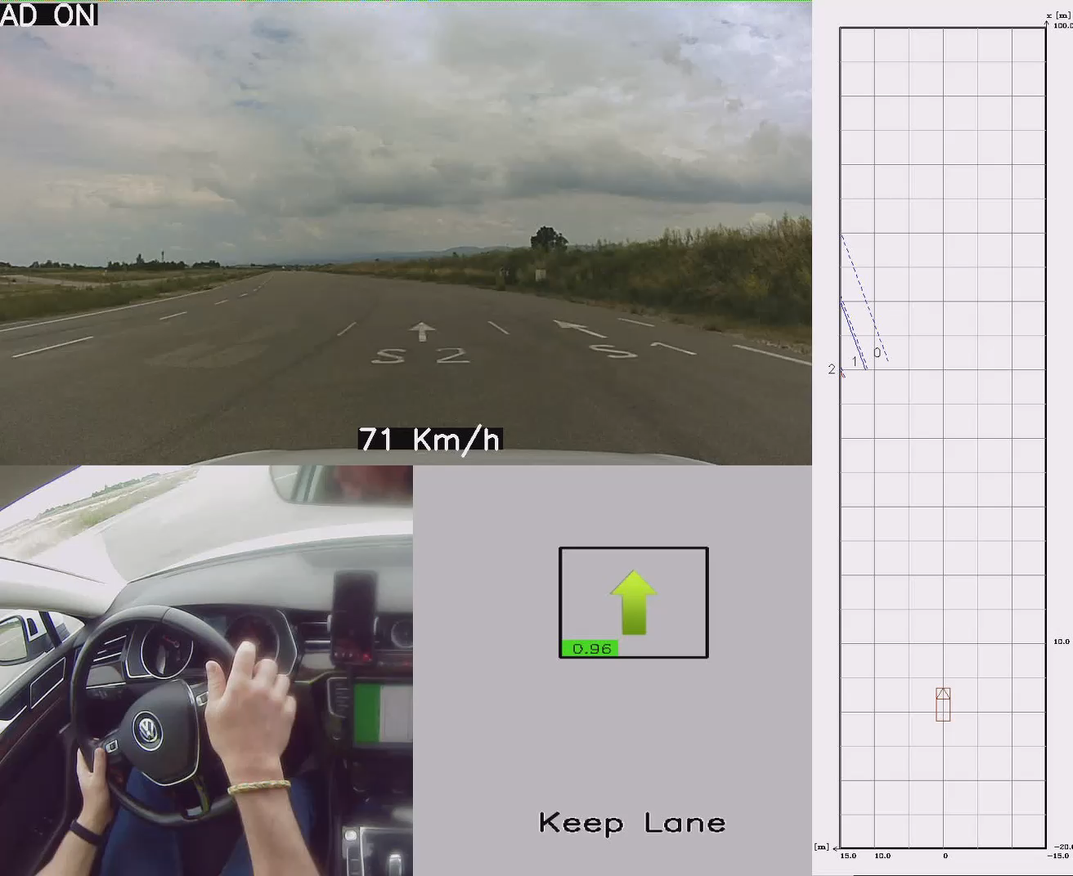
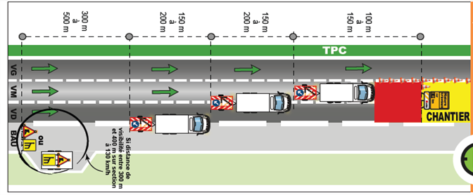
AV negotiating a lane closure
Road works, 2 lanes closed by
warning trailer.
InDiD test report:
COCSIC_2.6.3.4-Rapports-de-tests_Franchissement Balisage

Slide 13
Successes / Continuations

Slide 14
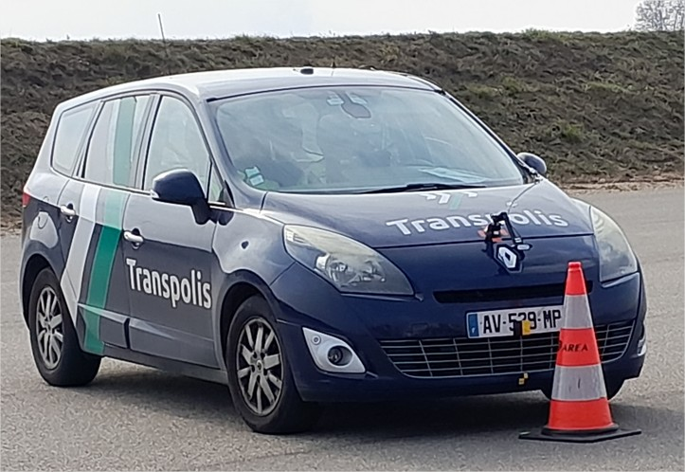
Successes and continuations
Successes
ODD extension for a VA covering two new use cases: negotiating a toll barrier and a single lane closure
Modeling of Virtual Lanes on a toll plaza in an area without ground markings
Operational interface between a toll equipment supervisor and RSUs
Negotiating RWW with single lane closure validated on test tracks
Continuations
VA Negotiating Road Works:
  Topographic survey (precision of positions) to standardize and optimize
  Extend the scope of the types of work zones taken into account (carriageway crossover, entry inside roadworks….)
VA Negotiating a toll barrier:
  improved low speed control in areas near the barrier to facilitate passage of the toll lane
  Integration of redundancy of traffic Light states by on-board perception
  Management of the location transition between HD MAP and MAPEM
Assessment of both Use Cases on open road.
Notes:
Mentionner les tests d’interopérabilité pour les messages V2X (IVIM, DENM, MAPEM, SPATEM)

Slide 15
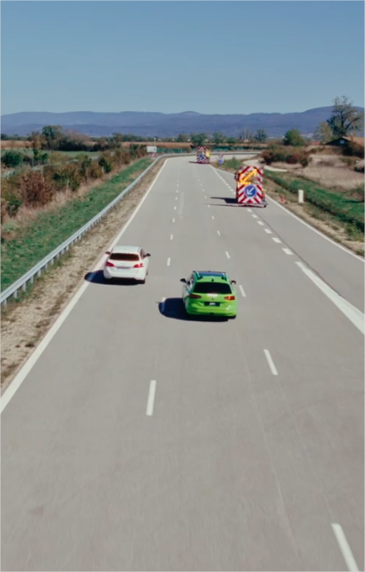
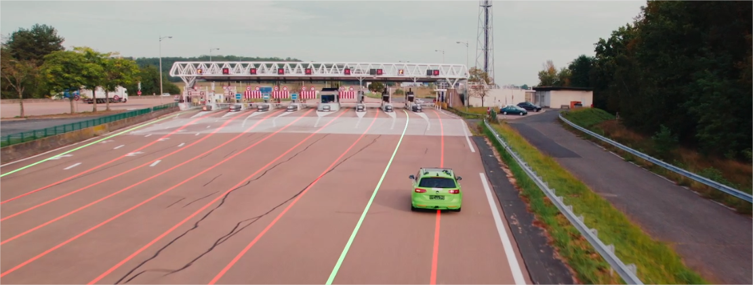
Thank you for
listening

